Slide 1
Employing people
With Disabilities, Support and Health
Needs

Slide 2
History of ELITE
VISION - To enable vocational experience and / or paid employment opportunities for
people with disabilities of all ages
MISSION - To enable individual with disabilities, to access, obtain and maintain paid
employment via appropriate support
Established in 1994
Voluntary organisation
Registered Charity
Originally set up to work with adults with learning disabilities living in Mid Glamorgan
Now work with people with learning disabilities, physical disabilities, sensory impairments, mental health conditions and those at a disadvantage of finding employment
Aged 14-65 years
Rhondda Cynon Taff, Merthyr Tydfil, Bridgend, Caerphilly, Swansea, Neath and Port Talbot, Cardiff and the Vale, Torfaen, Blaenau Gwent, Monmouthshire, Pembrokeshire, Carmarthenshire, South Powys, South Ceredigion, Newport, North Wales, Ireland and Europe
Funders: Jobcentre Plus; Local Authorities of Rhondda Cynon Taff, Bridgend and Powys; Big Lottery and WEFO
Other past funders: BBC Children in Need, European Social Fund, Interreg and Leonardo project, Local Education Authority
Head Office: Magden Park, LLantrisant
Branches: Llandarcy, Brecon, Rogerstone(Newport), Merthyr Tydfil and the use of other outreach venues
Set up ELITE Training Solutions in 2018.
Training Module
Disability Awareness

Slide 3
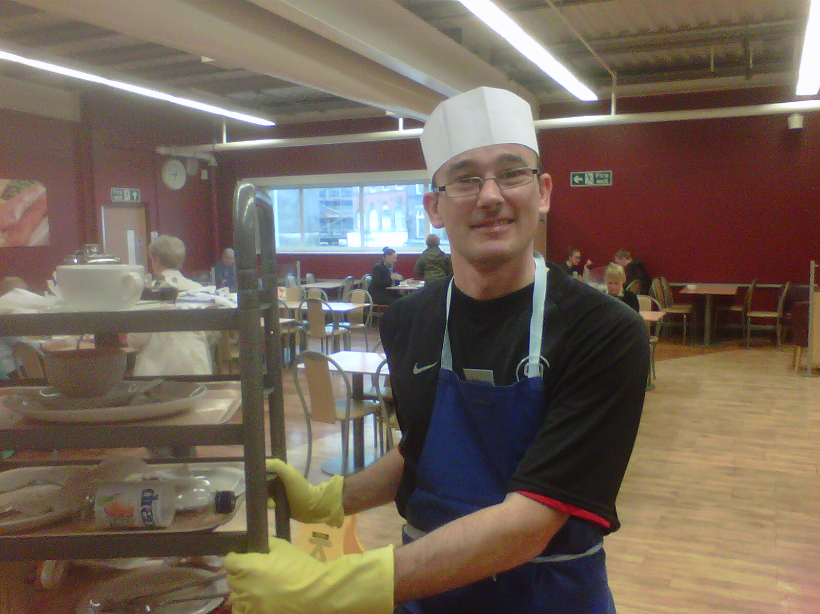
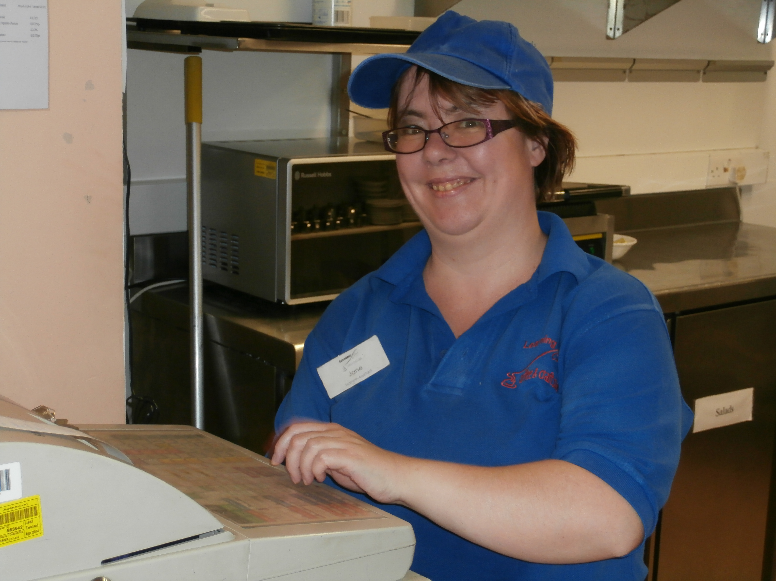
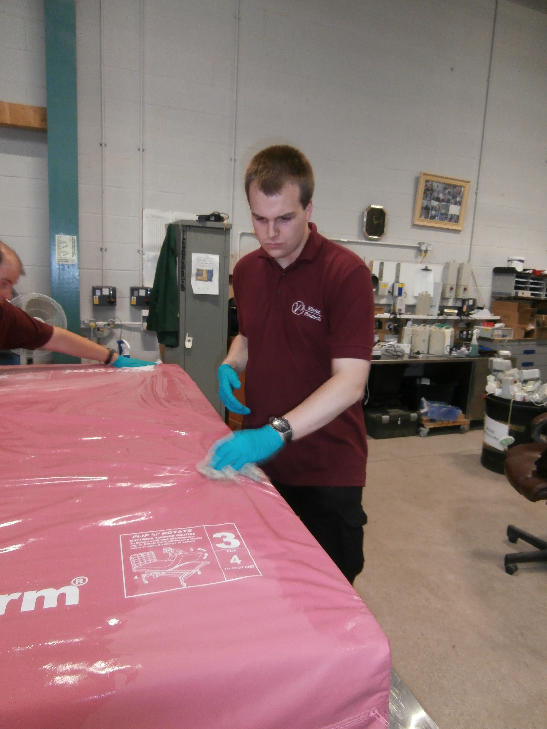
Benefits of Employing People with disabilities.
Low employee turnover
Dedicated and reliable employees
Upskill existing staff on disability awareness
Community recognition
Raise your profile with your customers
You could become a ‘Disability Confident’ Employer
Increase your ‘talent pool’ when recruiting
Diverse workforce
People with disabilities build strong relationships with customers

Slide 4
Myths &
Misconceptions

Slide 5
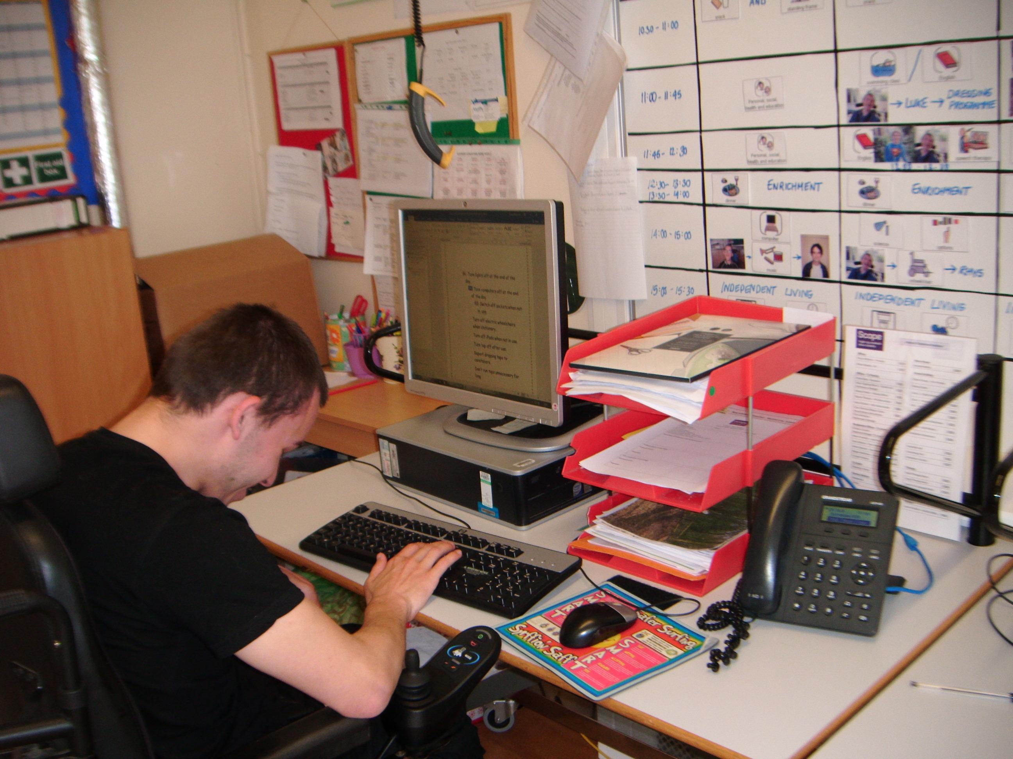
Myths and Misconceptions
Misconception
“Employing a person with a disability will affect my organisation’s productivity and financial performance.”
In Reality
People with disabilities can bring economic benefits which can save time and money

Slide 6
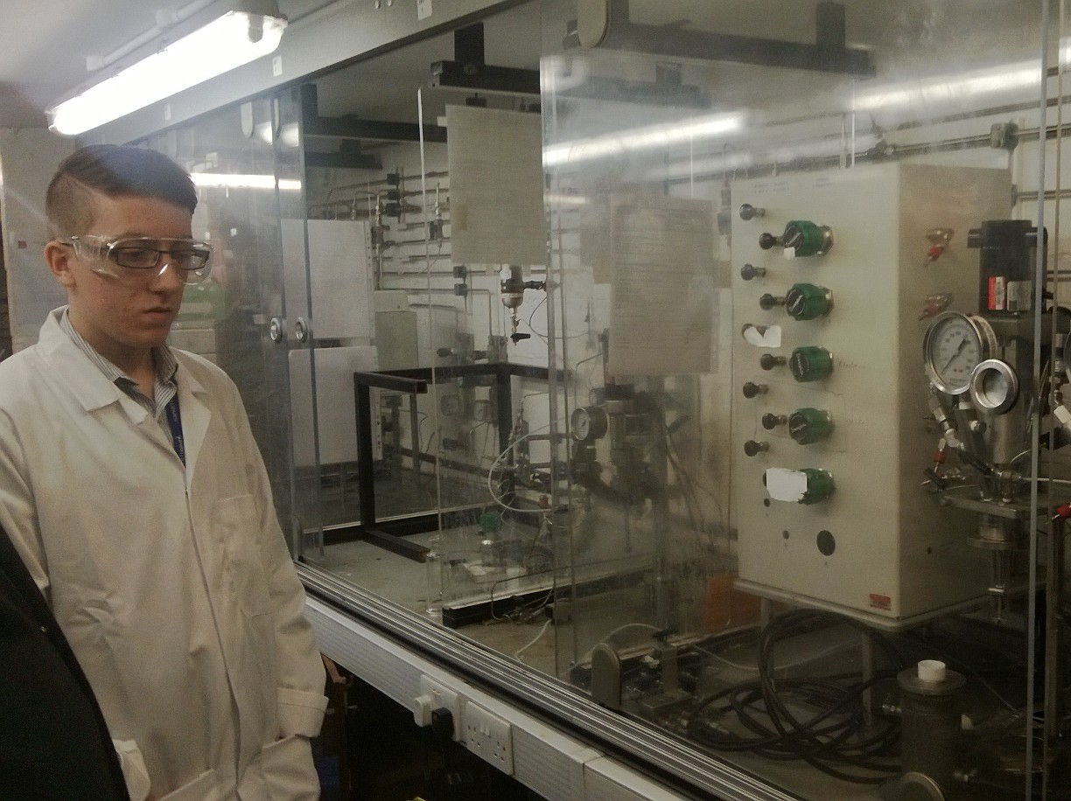
Myths and Misconceptions
Fact
People with a disability generally stay in work longer, take less sick days and are reliable timekeepers.
Research suggests
People with a disability stayed in their job 3.5 times longer that their non-disabled co-workers.(7)
Research also suggests that there are higher costs incurred by employers through lateness, sick leave and absence by non-disabled workers than employees with a disability. (8)
7,8 Beyer and Beyer (2017). Reliability of worker, p.20.

Slide 7
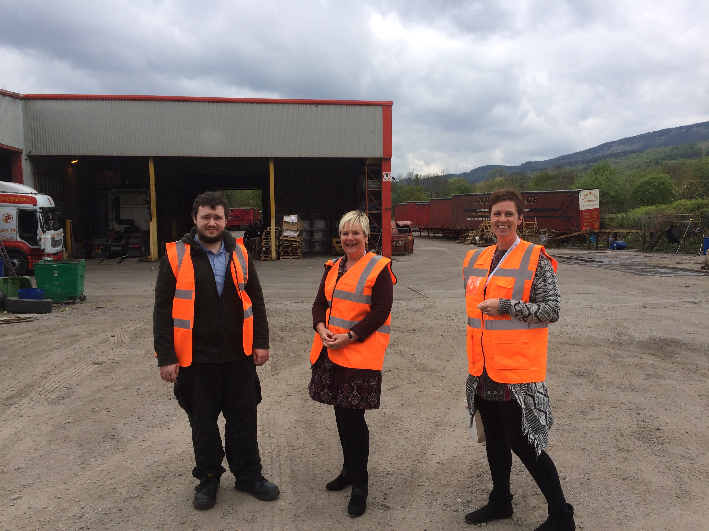
Myths and Misconceptions
Misconception
“People with a disability will struggle to perform effectively in a role at my organisation.”
In Reality
With the right support, and if placed in a suitable role, people with a disability can perform exceptionally well – and they can have a significant positive effect on staff morale

Slide 8
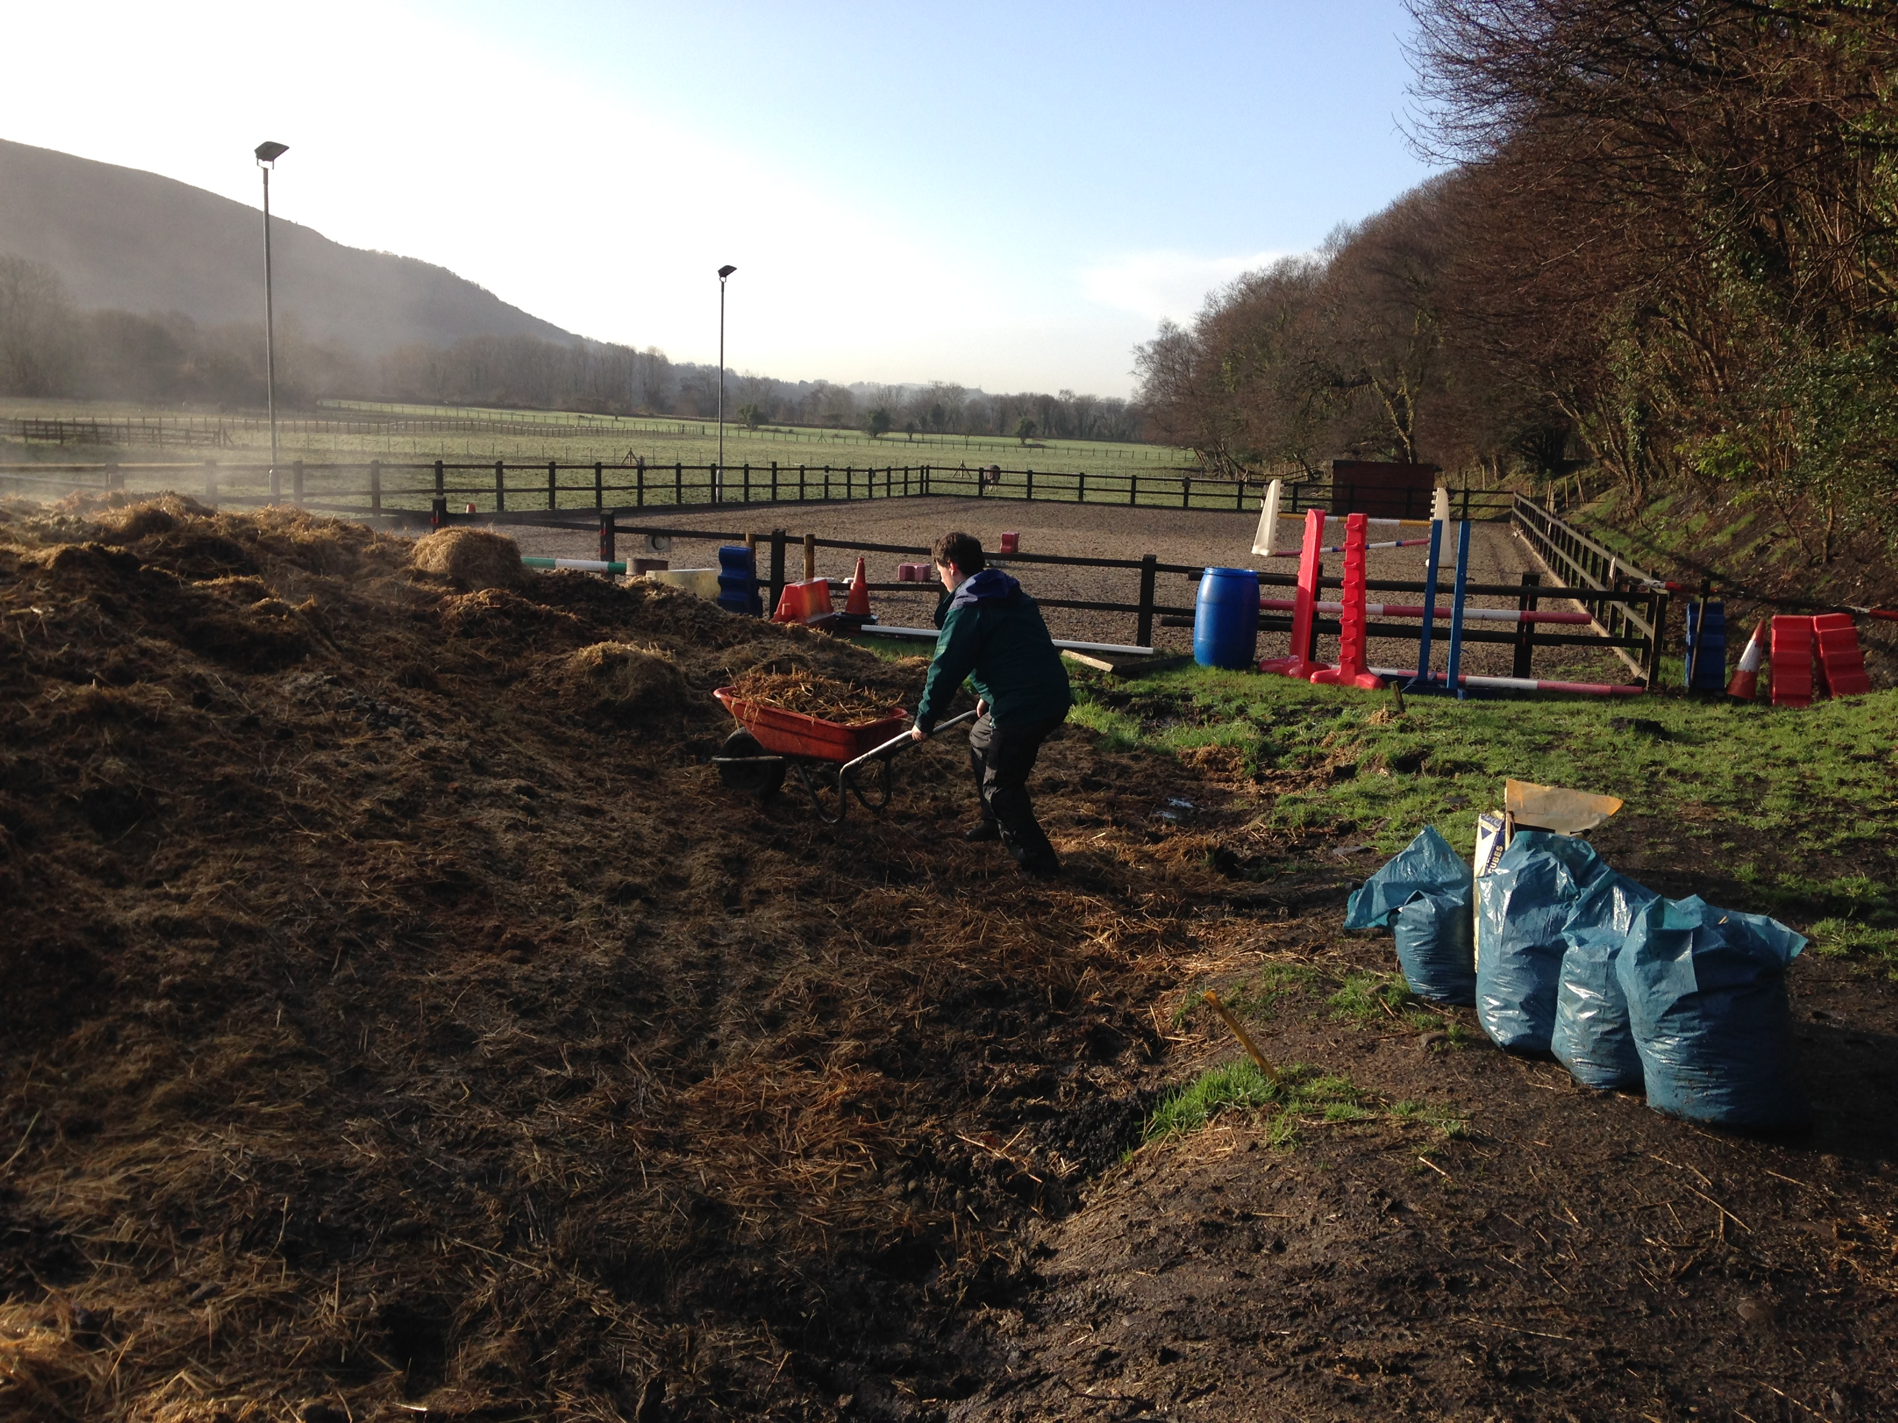
Myths and Misconceptions
Fact
Many people with a disability are fit to work and can do a job well, and can be just as productive at work as people without a disability.
Research suggests
Employers are more likely to have a positive view of work performance of people with a disability if they have previously employed somebody with a disability.
Beyer and Beyer (2017). Economic Benefits

Slide 9
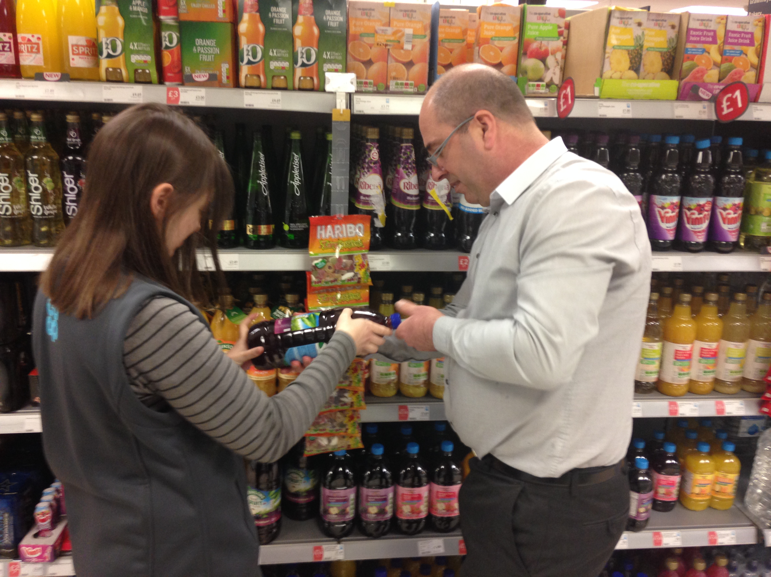
Myths and Misconceptions
Misconception
“There’s little or no support for me as an employer when employing a person with a disability.”
In Reality
We provide tailored training and support to both the person with a disability and you as the employer.

Slide 10
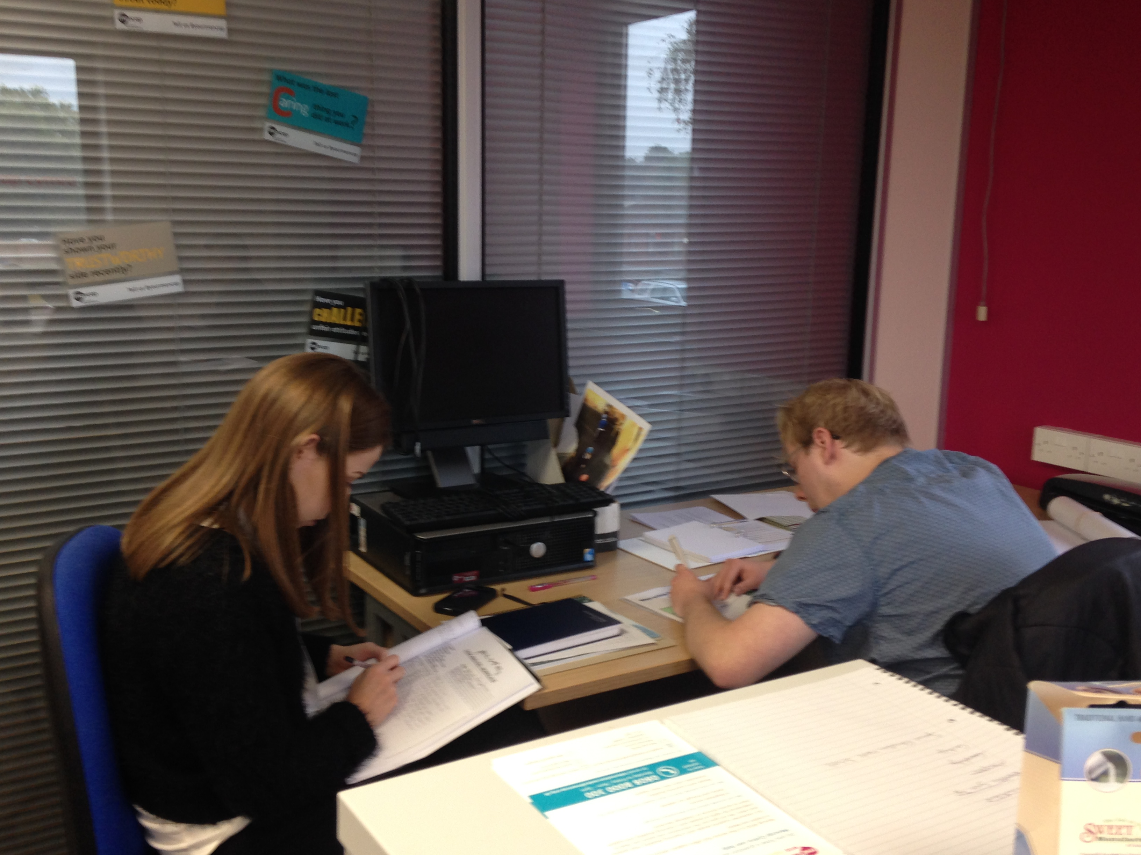
Myths and Misconceptions
Fact
ELITE Training Solutions are able to provide specific training to the employers staff and colleagues to enable them to support the person with a disability within their role.
Research suggests
Providing training and support such as ‘Disability Awareness Training’ to employers has enabled the introduction of people with disabilities to the work force and enhanced social integration and valued roles

Slide 11
Disability Awareness Training Taster

Slide 12
Overview of session
Common misconceptions of Mental Illness
Tips to help people with Mental Illness
Overview of Autism
How we can help
Common Myths and Misconceptions

Slide 13
Common Mental Illnesses
Depression
Anxiety Disorders
Obsessive Compulsive Disorder
Schizophrenia
Dementia
Bulimia / Anorexia
Attention Deficit Hyperactivity Disorder (ADHD)
Multiple Personality Disorder

Slide 14
PRACTICAL EXERCISE
How are Mental Health and Physical Health treated differently?
We all have a body and we all have a brain, so we all have physical health and mental health.
Raise your hand if :
You went to a dentist’s appointment in the last year
You went to a doctor’s appointment in the last year
You took medication in the last year
You were absent from work due to physical health in the last year
HOW DID IT FEEL TO ANSWER THESE QUESTIONS ?

Slide 15
PRACTICAL EXERCISE
Now raise your hand if :
You saw a mental health professional in the last year
You took any psychiatric medications in the last year
You were absent from work due to mental health in the last year
HOW DID IT FEEL TO ANSWER THESE QUESTIONS ?

Slide 16
PRACTICAL EXERCISE
DISCUSSION QUESTIONS :
How are the Mental Health questions different from the previous ones? What makes them different?
Why are some things harder to talk about than others?
What does parity of esteem for mental health mean?

Slide 17
Mental Health Quiz

Slide 18
Mental health problems are rare

Slide 19
Mental health problems are rare
Mental Health problems affect 1 in 4 people in any one year. So, even if you don’t have a mental health problem, it is likely your friend, a family member or colleague will be affected.

Slide 20
People with Mental Illness are violent

Slide 21
People with Mental Illness are violent
People with Mental Illness are much more likely to be the victim of violence. The violence myth makes it harder for people to talk openly about mental health problems. It can also make friends reluctant to stay in touch.

Slide 22
On average, people with mental illnesses die 10 years younger.

Slide 23
On average, people with mental illnesses die 10 years younger.
But it’s not the mental illness that kills – it’s the discrimination. The physical health needs of people with mental health problems are often dismissed, causing higher rates of death from heart attacks, diabetes and cancer for people with severe mental illness.

Slide 24
The stigma and discrimination around mental illness can be more difficult than the illness itself.

Slide 25
The sigma and discrimination around mental illness can be more difficult than the illness itself.
In a recent survey, 58% of people said this stigma and discrimination is equally as damaging, or harder to deal with than the illness itself. 87% of people with mental illness has experienced discrimination.

Slide 26
People can’t work if they have a mental health problem

Slide 27
People can’t work if they have a mental health problem
With 1 in 4 people affected by mental illness, you probably work with someone who has mental illness. Many successful people such as MP’s, sport stars and business leaders, have been open about difficulties with their mental health.

Slide 28
HOW DID YOU DO?

Slide 29
Discussing Mental Health with staff
Choose an appropriate place to talk - somewhere private and quiet where the person feels comfortable and equal. Possibly a neutral space outside of the workplace.
Encourage people to talk - people can find it difficult to talk about their mental health but it helps to have an open culture where conversations about mental health are routine and normalised. Ask simple, open and non-judgmental questions and let people explain in their own words how their mental health problem manifests, the triggers, how it impacts on their work and what support they need
Don’t make assumptions - don’t try to guess what symptoms an employee might have and how these might affect their ability to do their job – many people are able to manage their mental health and perform their role to a high standard but may require support measures when experiencing a difficult period.
Listen and respond flexibly - everyone’s experience of a mental health problem is different so treat people as individuals and focus on the person, not the problem
Be honest and clear - if there are specific grounds for concern, like high absence levels or impaired performance, it’s important to address these at an early stage

Slide 30
Discussing Mental Health with staff
6) Ensure confidentiality - people need to be reassured of confidentiality. It’s sensitive information and should be shared with as few people as possible.
7) Develop an action plan - work with your employee to develop an individual action plan which identifies the signs of their mental health problem, triggers for stress, the possible impact on their work, who to contact in a crisis, and what support people need
8) Encourage people to seek advice and guidance - people should speak to their GP about available support from the NHS such as talking therapy.
9) Seek advice and guidance yourself - Occupational Health (if you have it) can provide tailored advice to support both employers and employees. If relationships have become strained or confrontational mediation can help. Small businesses can access the free Health for Work Adviceline service provided by NHS occupational health services.
10) Reassure people - people may not always be ready to talk straight away so it’s important you outline what support is available, tell them your door is always open and let them know you’ll make sure they get the support they need

Slide 32
What is AUTISM ?
Autism is a lifelong developmental disability that affects how a person communicates with and relates to other people. It also affects how they make sense of the world around them.

Slide 33
AutismQuiz

Slide 34
Autism is more
often diagnosed
with boys than girls ?

Slide 35
Autism is more
often diagnosed
with boys than girls ?
Autism is identified at least 4 times more in males than in females.

Slide 36
People with Autism are all eccentric geniuses ?

Slide 37
People with Autism are all eccentric geniuses ?
Some have exceptional talents e.g visual art, maths etc. however some people with autism have a learning disability

Slide 38
People with Autism do not easily understand what other people are thinking ?

Slide 39
People with Autism do not easily understand what other people are thinking ?
People with autism have difficulty with social communication, meaning they may not understand tone of voice, facial expressions and emotions.

Slide 40
People with Autism have below average intelligence ?

Slide 41
People with Autism have below average intelligence ?
Some people with autism have very high intelligence.

Slide 42
Adults with autism are not capable of working ?

Slide 43
Adults with autism are not capable of working ?
Lots of people with autism are more than capable of working. Appropriate job matching can ensure an employer has an exceptional employee. However the sad fact is the majority of adults with autism are not working. Only 16% of adults with Autism are in full time employment.

Slide 44
HOW TO HELP
Speak in a clear, consistent way
Allow people time to process what has been said
Avoid misunderstandings in the workplace by increasing colleague/ others awareness
If person is aloof or uninterested in talking to others or “says the wrong thing”, it is probably unintentional due to the person’s communication difficulties
If the person tries too hard to fit in and irritates other people, try to be patient and explain and reinforce the boundaries

Slide 45
HOW TO HELP
If the person becomes anxious, try to find out what is causing the problem
Make instructions concise and specific, e.g. rather than saying “give everyone a copy of this”, say “make 3 photocopies of this and give one each to Sam, Mary and Paul”
Ask person to repeat instructions back to you so you are sure they have understood
Ensure the environment / work schedule is well structured

Slide 46
HOW TO HELP
Explain workplace/club etiquette and unwritten rules of the workplace/club
Provide sensitive, but direct feedback. If a person completes a task incorrectly, do not allude to or imply any problems – instead explain tactfully, but clearly, why it is wrong, check they have understood and set out exactly what they should do instead. Give positive feedback wherever appropriate

Slide 47
HOW TO HELP
Provide reassurance in stressful situations. People with ASD can be quite meticulous and can become anxious if their performance is not perfect
They may become very stressed in a situation such as IT failure
Help by providing concrete solutions to these situations, e.g. if the photocopier breaks down, use the one on the 3rd floor, or reassure the person that if they arrive late due to transport problems or other unpreventable factors, that this is not a problem

Slide 48
HOW TO COMMUNICATE
Speak slowly, simply and at a normal volume
Avoid broad open-ended questions
Avoid standing too close
Avoid slang, idioms, sarcasm and humour
Don’t worry if the person isn’t making eye contact
Avoid touching them unexpectedly
A employee with Autism isn’t intentionally trying to be rude or impolite.

Slide 49
Positive characteristics of an employee with Autistic Spectrum Conditions
Conscientious, reliable and honest
Enthusiastic and have a propensity for research, thus developing a broad and deep knowledge in areas of interest
Not inclined to lie or be a social manipulator
Persistent – when set on doing something, it will be seen through
Have highly original perspective on problem solving
Can recall fine details others may miss
Good work ethic
Exceptional memory
Pay attention to detail

Slide 50
IN SUMMARY
I wanted to take this opportunity today, to firstly discuss the positives about employing people with disabilities and to secondly identify that there is specialised support and guidance that ELITE Training Solutions can provide employers to enable you to become a diverse, disability confident employer.
Thank you for listening.
ANY QUESTIONS ?
cenglish@elitesea.co.uk 01443 226664 07966 620680

